Slide 1

Virtual Internship
Task-1
-Srihridai

Slide 2

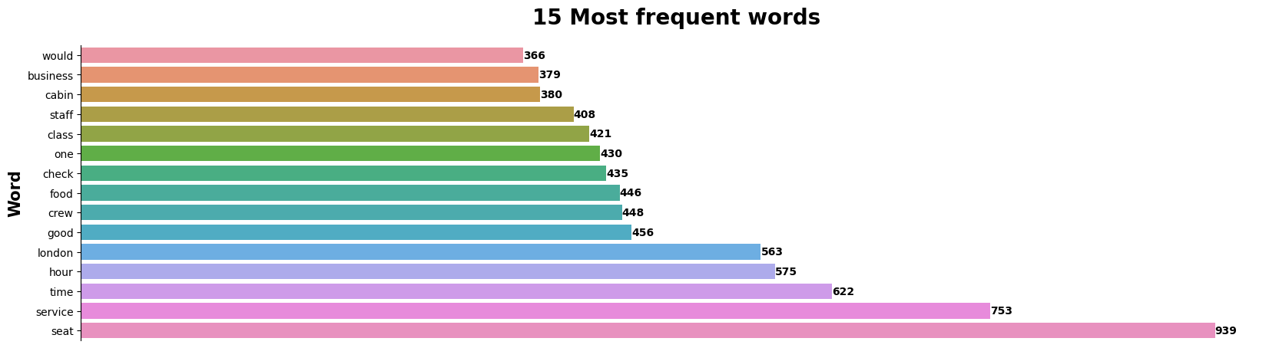
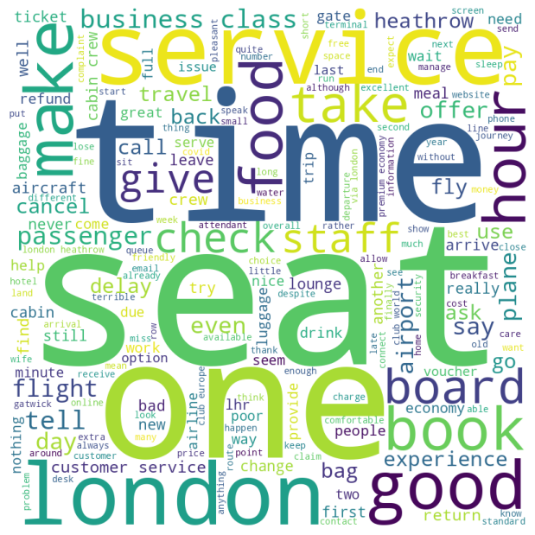
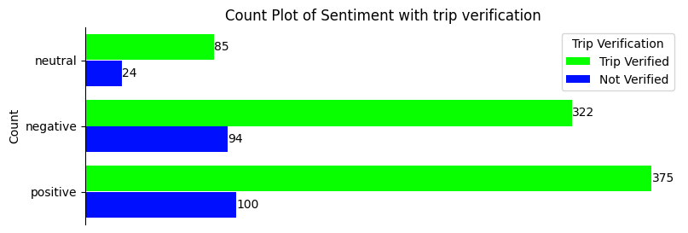
Sentiment Analysis of Reviews
Total 1000 reviews were scraped from the website.
Data was cleaned and new columns (like Trip Verification, Sentiment score, Sentiment) were added for better analysis.
VADER (Valence Aware Dictionary and sEntiment reasoner) sentiment analysis tool was used to find the sentiment of the reviews.

